Slide 1
Attention Model COVID segmentation

Slide 2
context₃
Decoder features
H
H
enc_channels
dec_channels
W
W
3 x 3
CONV
1 x 1 CONV
1 x 1
CONV
Context Keys
Decoder Queries
Decoder
Values
enc_channels
dec_channels
enc_channels
c_{i-1,j-1}
c_{i-1,j}
c_{i+1,j+1}
k_{i-1,j-1}
k_{i-1,j}
k_{i+1,j+1}
q_{i,j}
. . .
. . .
context₂
Neighborhood context vectors
NDA
. . .
f
H
enc_channels
.
Softmax
W
Attention weights
context₃
a_{i,j}
H
enc_channels
Neighborhood Decoder Attention (NDA)
Context Keys
W
Attention vector
over all (i, j)
Context Keys
Stacked Attention Map
1 x 1 CONV

Slide 3
Region
Context₁
Region
Context₂
Region
Context₃
Decoder features
H
H
H
H
C_{E}
C_{E}
C_{E}
C_{D}
W
W
W
W
Zero pad
Zero pad
Zero pad
1 x 1 CONV
C_{E}
3 x 3 CONV
C_{E}
W
Context Window Attention
Context Window Attention
Context Window Attention
Decoder features
H
C_{E}
Context Keys
Attention vector
Context Keys
Stacked Attention Map
H
4 x C_{E}
W
1 x 1 CONV
Region Decoded features
H
C_{E}
W

Slide 4
Transformed Context
Broadcasted point-wise multiplication
Element-wise addition
Channel-wise Dot product
2D Convolution (kernel size f1 x f2, output channels) + BatchNorm + ReLU
.
1 x 1
CONV
C_{E}
CONV
H+2
C_{E}
W+2
Context
Context Window Attention
H+2
C_{E}
Corresponding 8-neighbor context
8-neighbor pixel features
W+2
Over all 3 x 3 context-windows
Attended Context
1 x 1
CONV
Global Spatial
Softmax
Global Sum Pooling
Decoder feature map
tanh
.
H
Context-attended vector (i, j)
C_{E}
H
W
C_{E}
W
Pixel (i, j)

Slide 5
Multi-receptive context feature maps
Context₁
Context₂
Context₃
Broadcasted point-wise multiplication
Element-wise addition
Channel-wise Dot product
2D Convolution (kernel size f1 x f2, output channels) + BatchNorm + ReLU
2H
2H
2H
.
C_{E}
C_{E}
C_{E}
2W
2W
2W
CONV
1 x 1 CONV
C_{E}
1 x 1 CONV
C_{E}
1 x 1 CONV
C_{E}
.
.
.
Resampled
Decoder features
Nearest neighbor resampling
.
.
.
1 x 1
CONV
C_{E}
H
2H
C_{D}
. . .
. . .
W
. . .
C_{D}
Decoder features
2H
. . .
Stacked context pixels weights
2W
. . .
2W
Channel-wise Softmax
3 x 3
CONV
C_{E}
Unstack
. . .
. . .
. . .
. . .
. . .
. . .
. . .
. . .
. . .
Attended Context
Output feature map
2H
2H
2W
C_{E}
2W
C_{E}

Slide 6
Multi-CONV
64 channels, stride 2
MRL Attention Upsampling
MCR
Attention Decoder
CONV
1 x 1
2
Softmax
Input Chest CT slice
256 x 256
MRL Attention Upsampling
MCR
Attention Decoder
Output mask
Multi-CONV
64 channels, stride 2
MRL Attention Upsampling
Multi-CONV
128 channels, stride 2
CONV
3 x 3
64
/2
Grouped CONV
3 x 3, 64, g=4
/2
Grouped CONV
3 x 3, 32, g=4
Multi-CONV
256 channels, stride 2
MRL Attention Upsampling
DS CONV
3 x 3, 32
/2
CONV
5 x 5
32
DS CONV
3 x 3, 32
Multi-CONV
512 channels, stride 2
MRL Attention Upsampling
Multi-CONV
1024 channels, stride 2
MRL Attention Upsampling
Connected components
8
1024
8
2D Convolution (kernel size f1 x f2, output channels, stride) + BatchNorm + ReLU
Encoded feature map
CONV

Slide 7
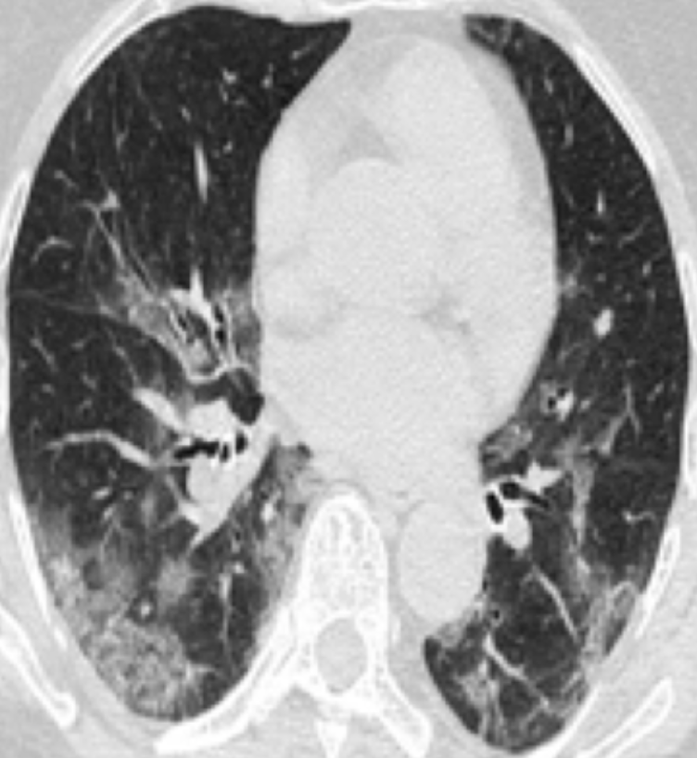
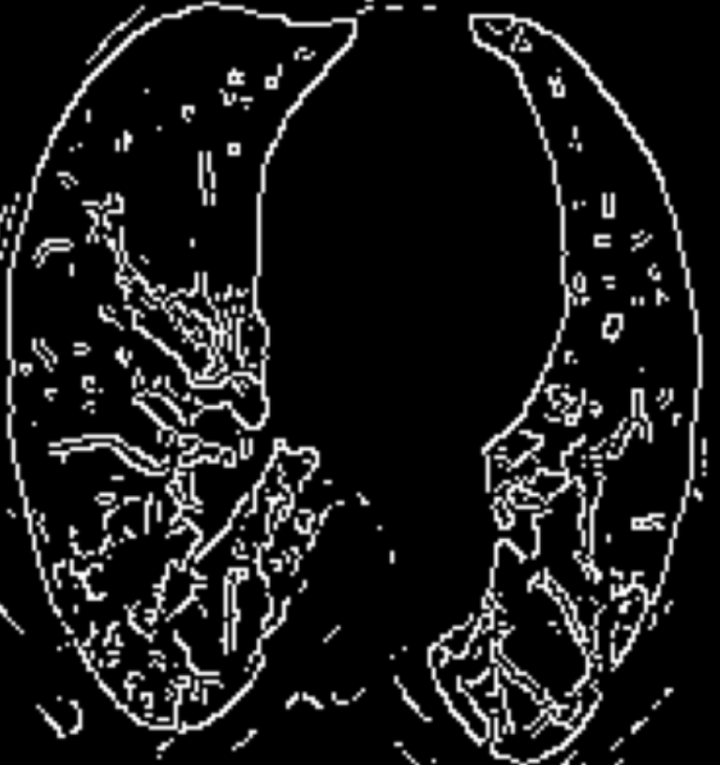
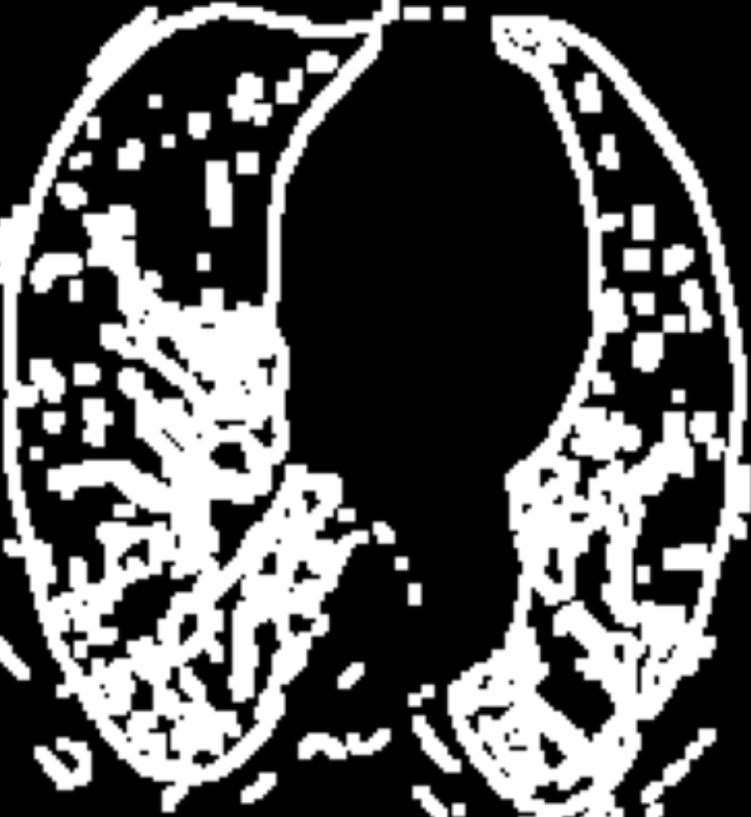
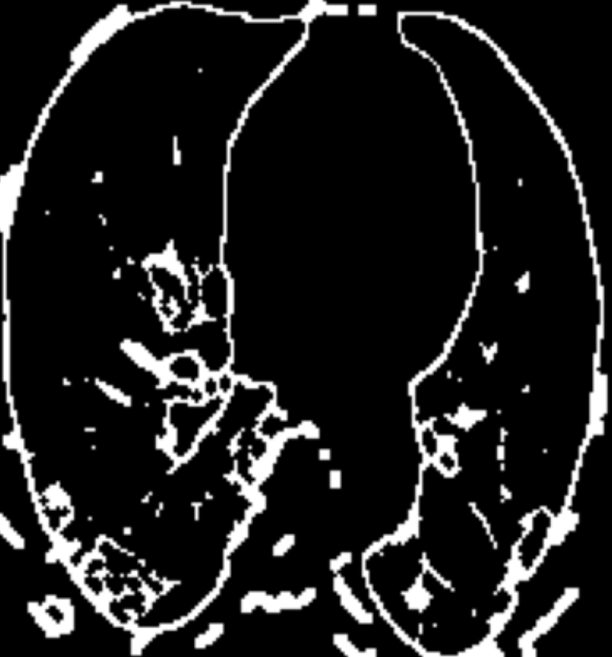
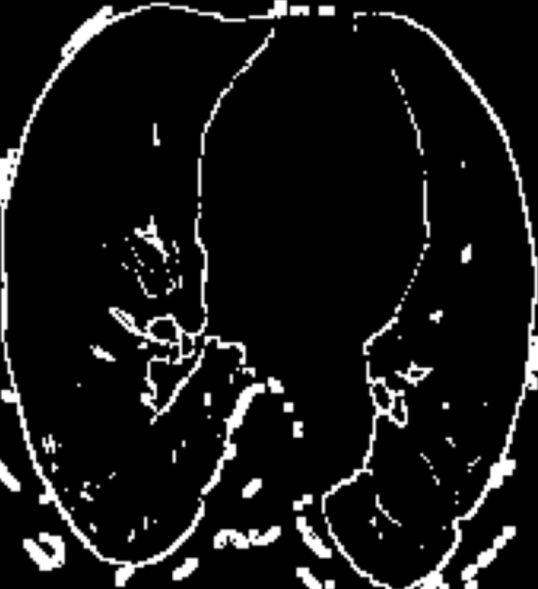
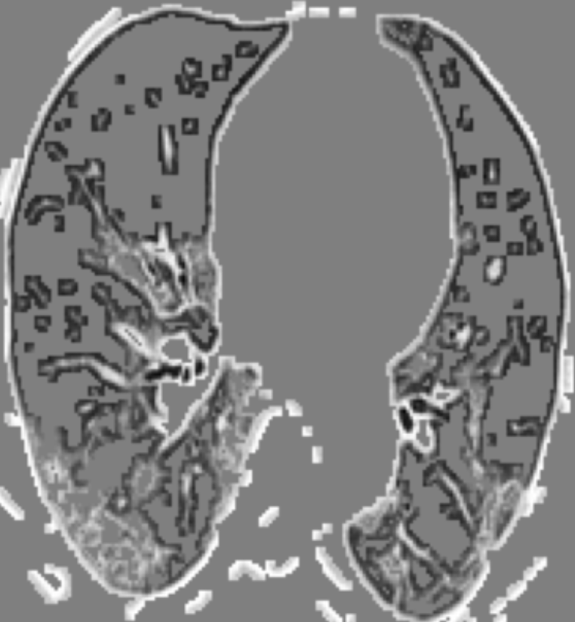
Canny Edge Detection
Dilation
Dilation
Pointwise Multiplication
Min-Max Normalization
Connected Components
Contours Extraction
Morphological Closing
Adaptive Otsu Thresholding

Slide 8
Multi-CONV (channels, stride)
3 x 3
CONV
channels
stride
5 x 5
CONV
channels
stride
7 x 7
CONV
channels
stride
mainline
features
contextual
features

Slide 9
W
Pixel (i, j)
tanh
Corresponding
8-neighbor
context
1 x 1 CONV
Global Spatial
Softmax
H
context₁
context₂
.
H
H
Global Sum Pooling
enc_channels
enc_channels
W
W
Context-attended vector (i, j)
Over all 3 x 3 context-windows

